Slide 1
Item Maintenance
CIS36 JAVA Final Project
Jiawei Huang

Slide 2



Item Maintenance is a System to save the item data. It used in Supermarket.
2.Server get the data from computer
1.Manager input the data in the computer
3.Cashier can scan the item by the server

Slide 3
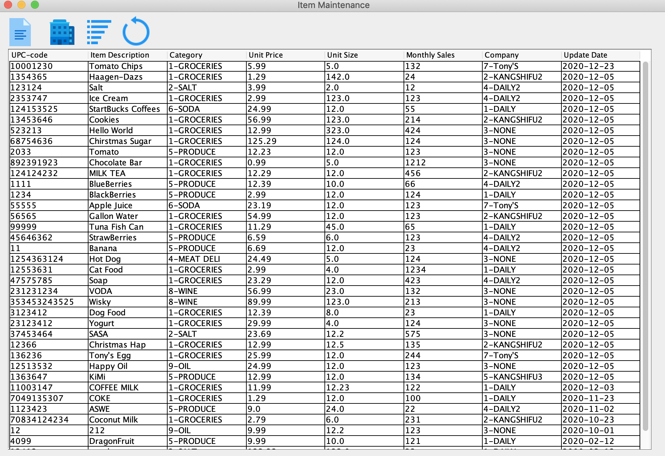
Batch Button: Add, Delete, Search
Company Button: Show the company list
Refresh button
Main GUI: Show the item list

Slide 4
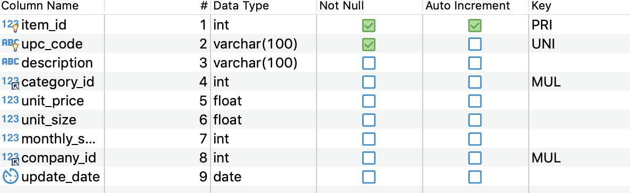
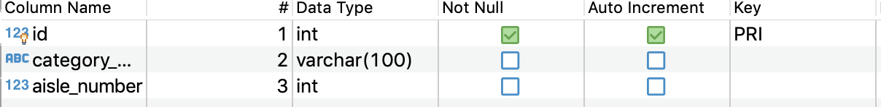
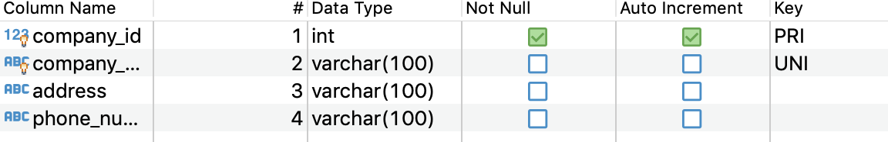
item
category
company

Slide 5
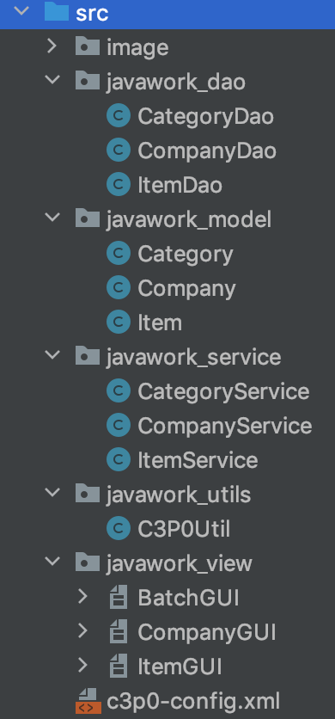
Structure of package
Dao package: operation about get, add, delete, search data on the database
Model package: Contains the class corresponding to the database table
Service package: Deal with data before saving in database or showing to user.
Util package: All Utils Class. C3P0Util is a tool to connect database
View package : All GUI. Show the data to user.

Slide 6
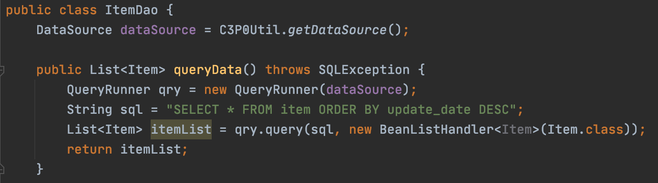
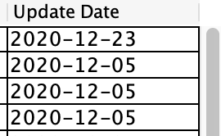
GetData From DataBase (Dao)
Get all the data from item order by new to old
Item data → Many Item object
Many Item object → List<Item>
query(): map the result of SQL queries to java objects list
Result: Get List<Item> itemList contained all the item data

Slide 7
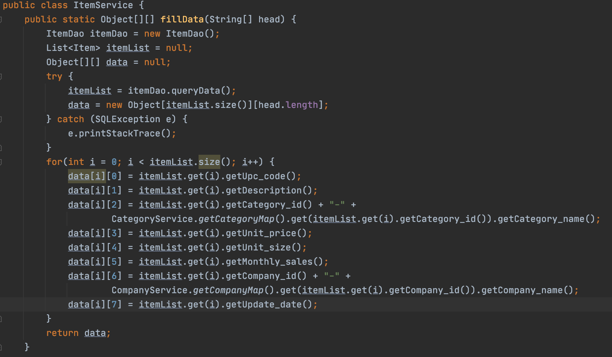
Deal with Data(Service)
The for loop traverses each list and fills it into a two-dimensional array
Result: List<Item> → Object[ ][ ]

Slide 8
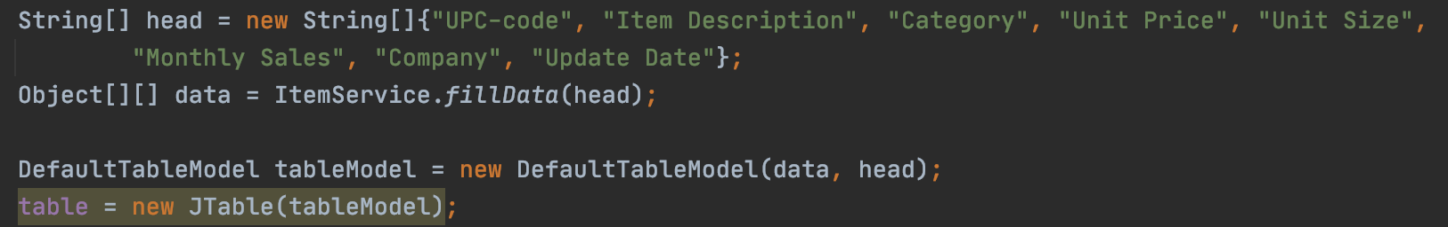
Show Data to User(View)
String[] head: Table’s header
Object[ ][ ] data → TableModel → JTable → JScrollPane→ JPane → display
Result: JTable displays Obejct[][] data in the form of a grid

Slide 9
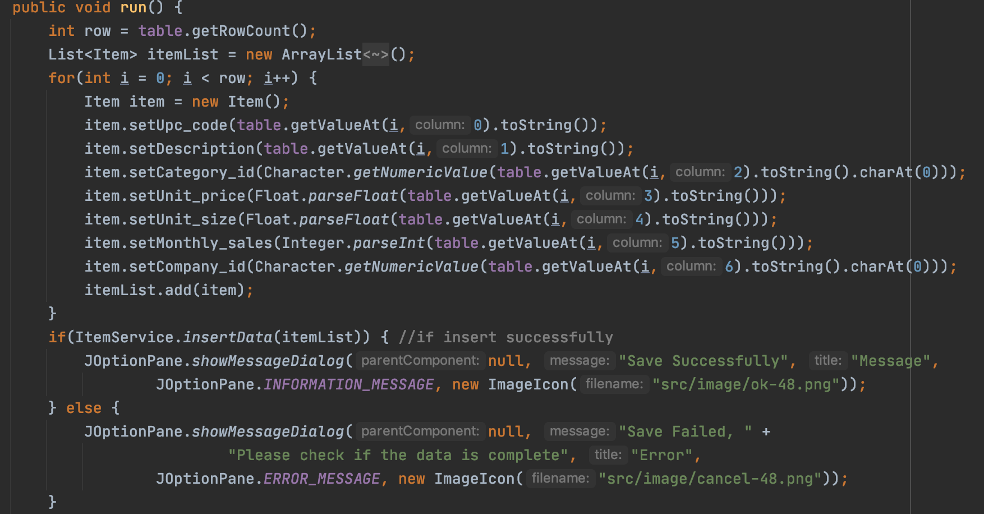
Add Item
Input new data
Click save button to save
Forloop: get data by accessing each line in table.
Table’s Data → many Item Objects
Many ItemObject →List<Item>
Result: Table’s Data → Many item objects → List<Item>

Slide 10
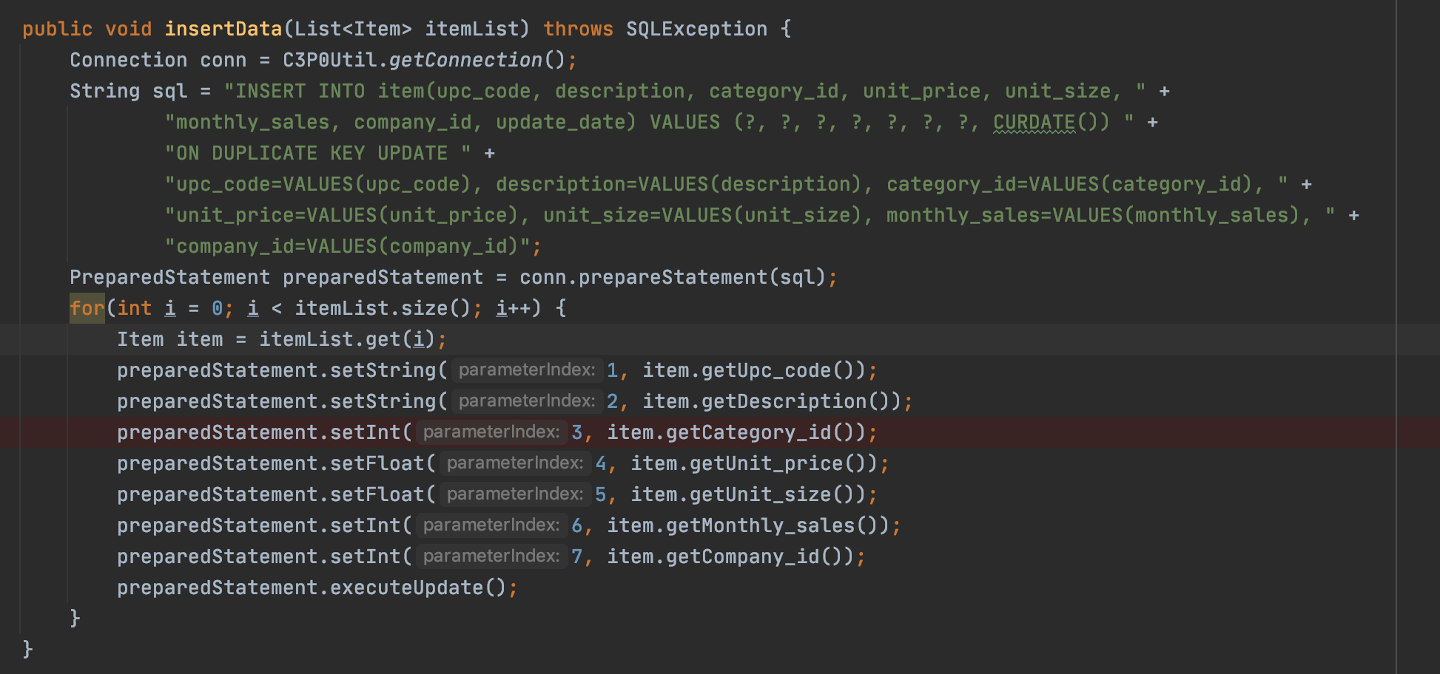
A List of new Items to insert
Forloop: Insert one row of data at a time
Insert data into database table, If upc_code is exist, update data.
If upc_code is not exist, add it as a new data.

Slide 11
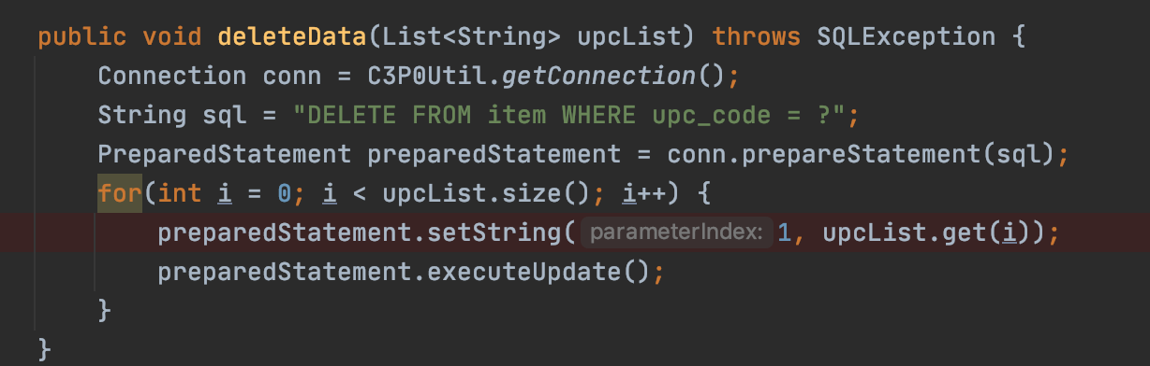
Delete Item
Click delete button to delete selected rows
Get all select row and find their upc_code string.
All upc_code → List<String>
A List of upc_code String to delete
Delete the data containing upc_code in the upcList

Slide 12
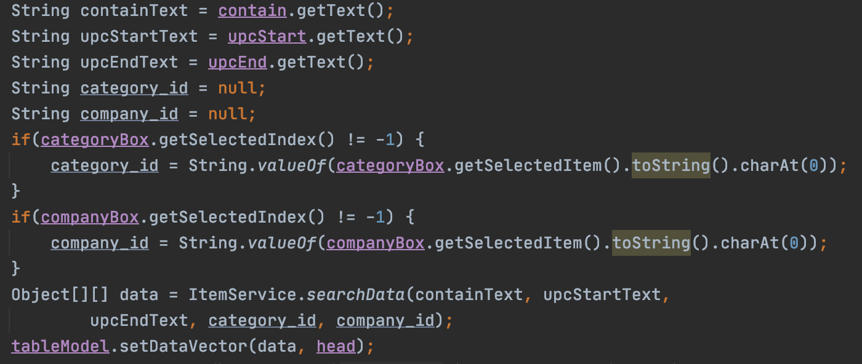
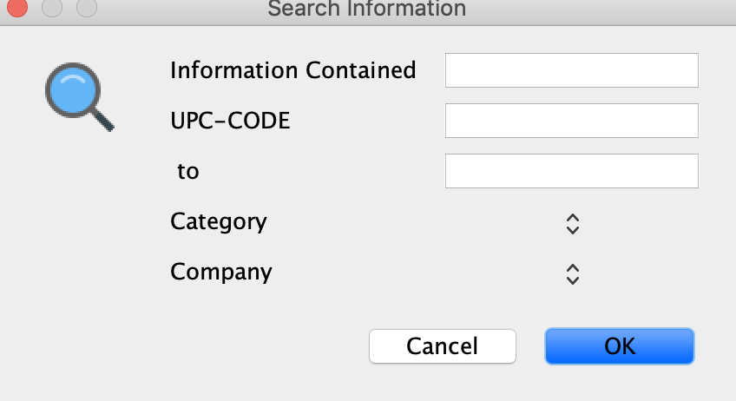
Search Item(View)
Get search information from user
Let search information as searchData() parameters
searchData(): return Object[][] containing search item data

Slide 13
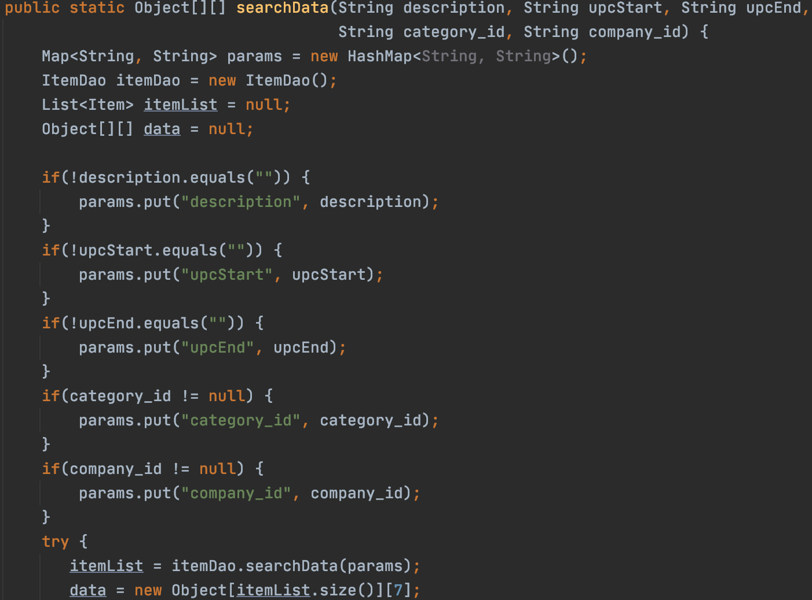
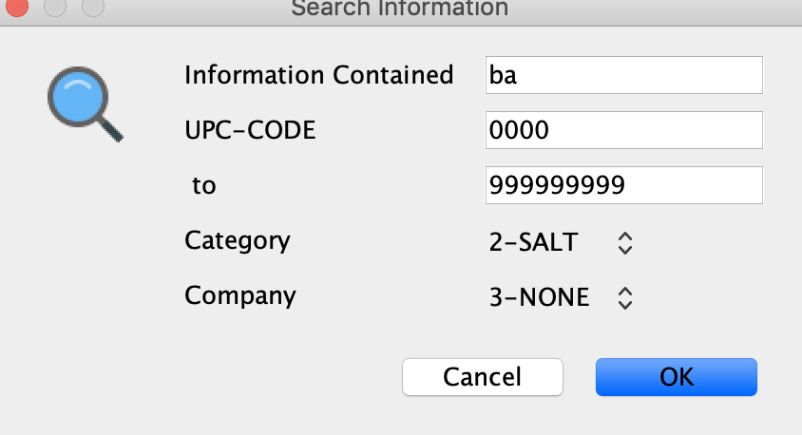
Search Item(Service)
Make search information to a Map
Example:
Key
Value
Description
upcStart
upcEnd
category_id
company_id
Ba
0000
9999999
2
3
If parameters != null or empty string, put the parameter into Map.
Example: string description = “Ba”;
Put “description” as Key, “Ba” as Value into Map.

Slide 14
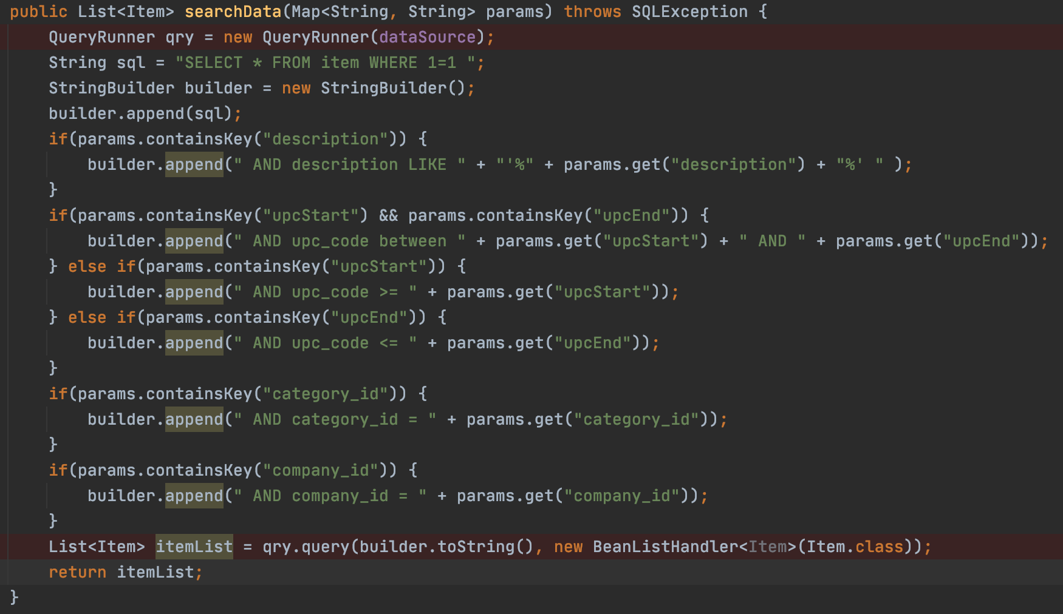
Search Item (Dao)
Where 1=1: The first condition does not affect the query results, so I don’t need to consider when I need to add “And” before query statement
The Map to build the sql statement
Like %input%: Fuzzy query data by description containing input information
Query data where upc_code between upcStart and upcEnd
After all append, The sql statement is complete.
Get result and Put the search results into List<Item>
Again: List<Item> → Object[ ][ ] → JTable → Display

Slide 15
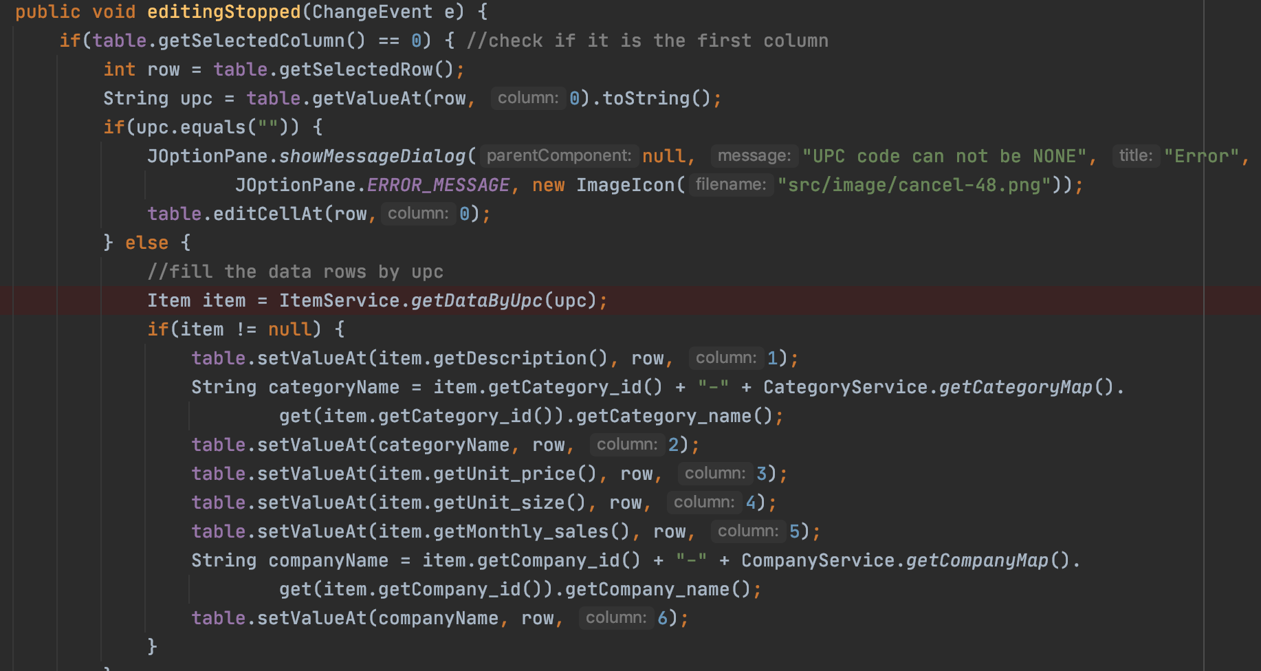
When user finish their edit, editingStopped() will run.
When the user enters upc_code in the first column, the relevant data is automatically searched from the database and filled into the table
upc_code “123124” is exist in database, fill data into the table

Slide 16
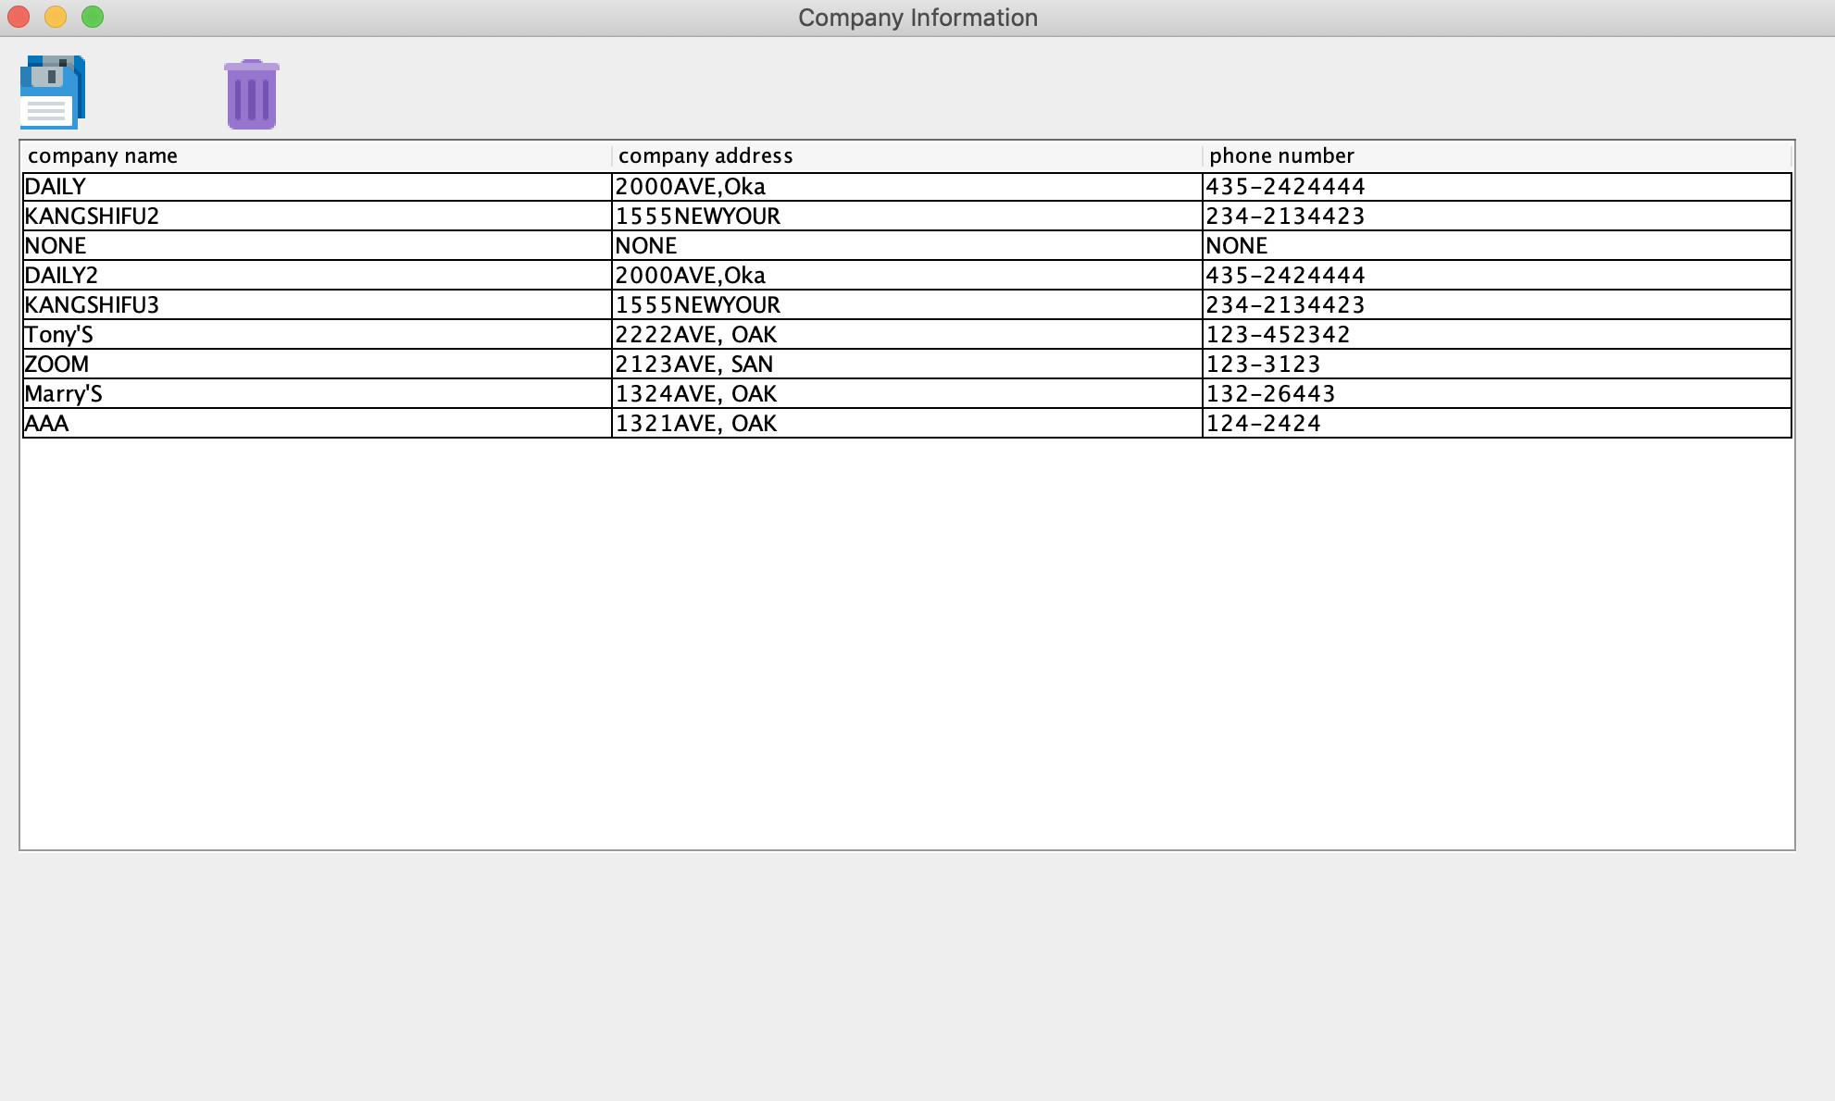
Company interface is same as item interface.
GetCompanyData(Dao) → Deal with CompanyData(Service) → Show in JTable(View)

Slide 17
Thank you!

